Slide 1


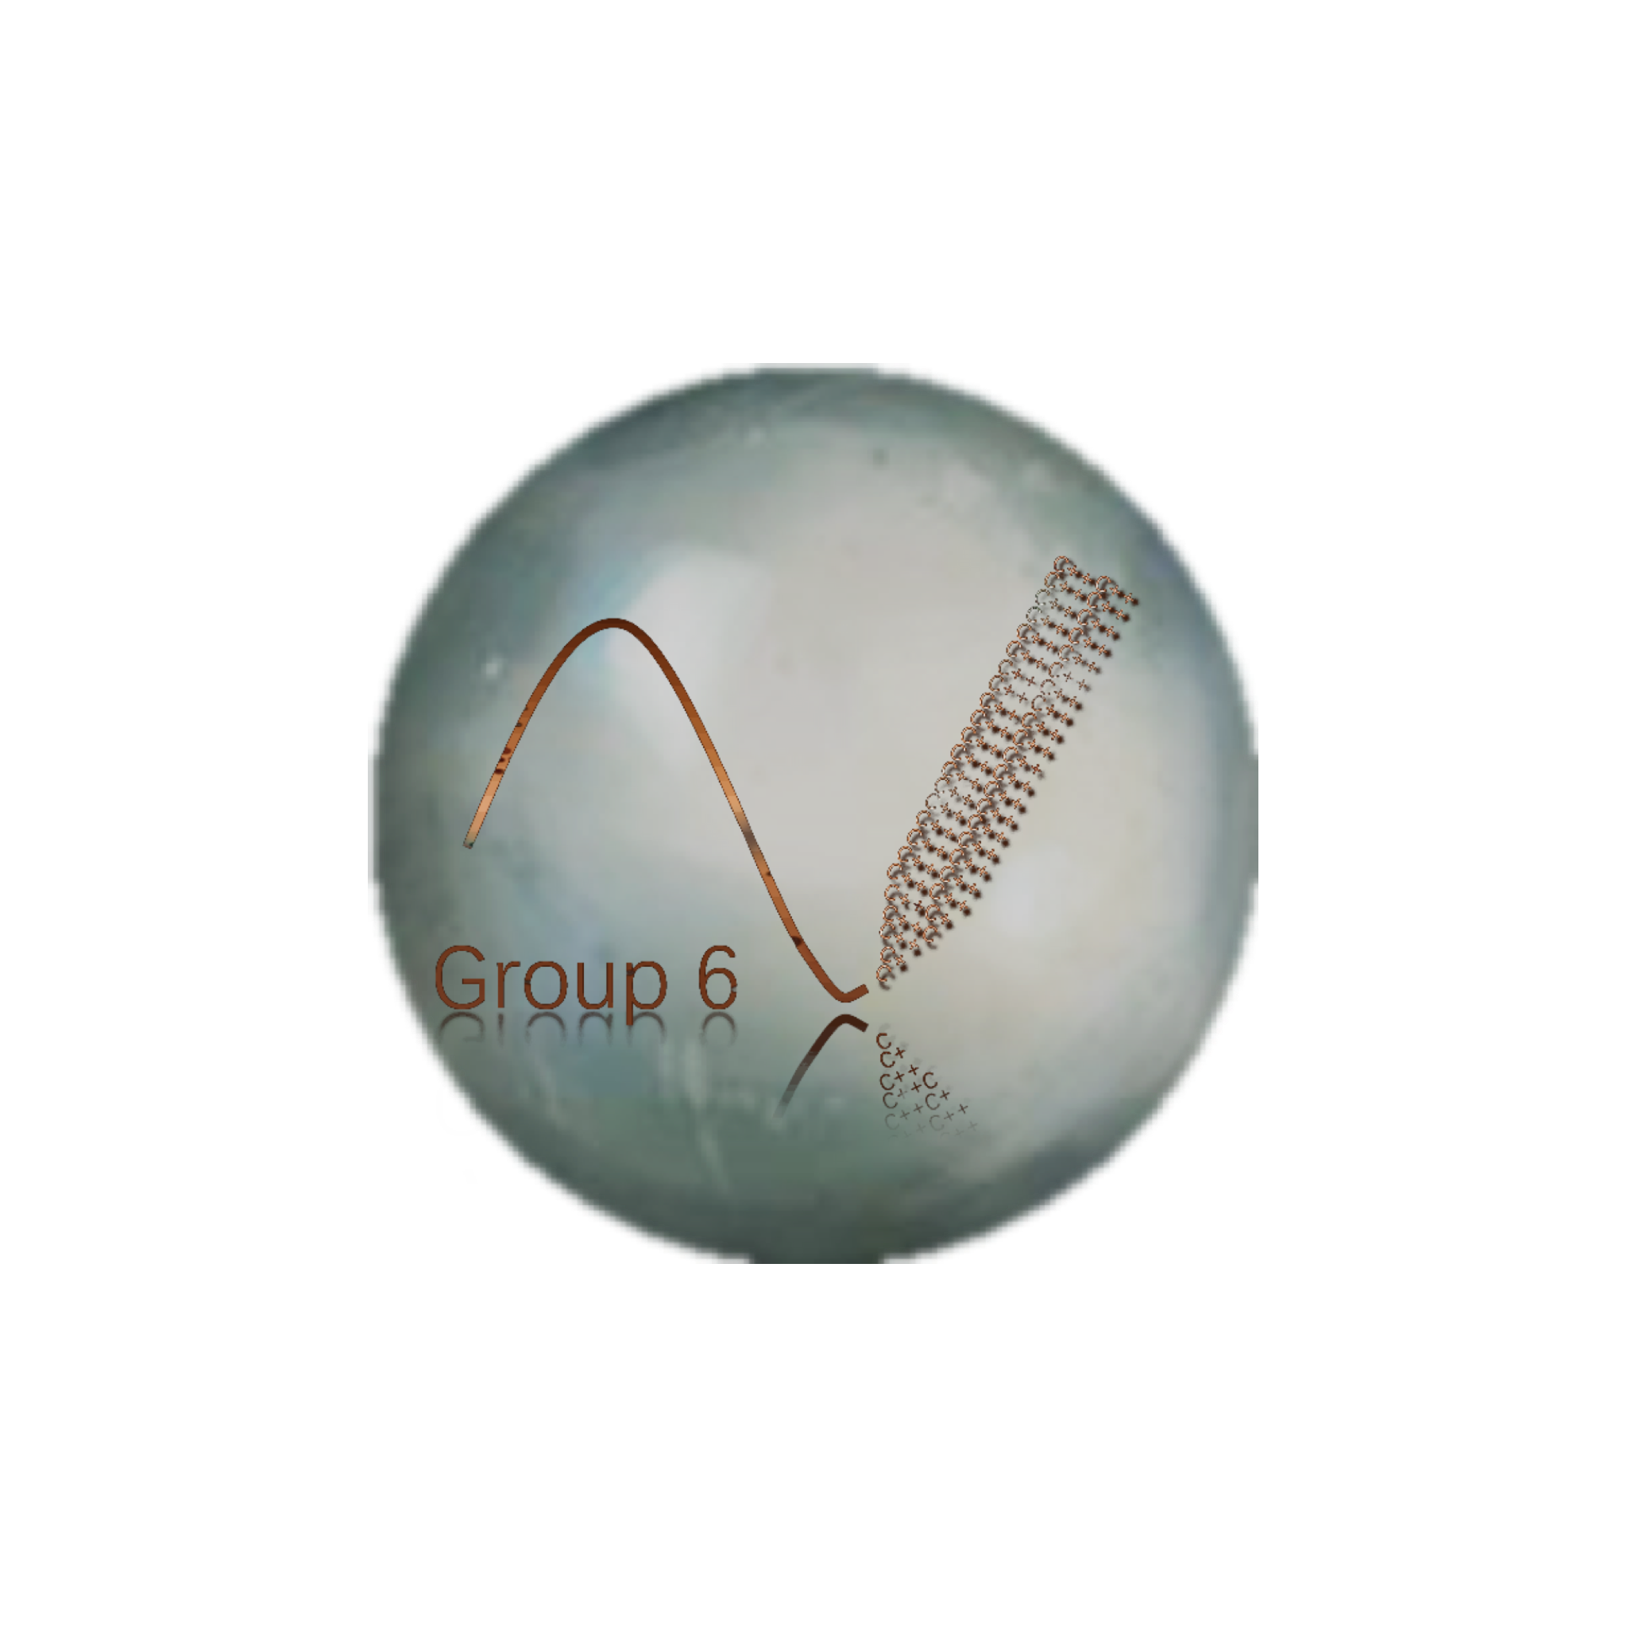
MyPainter
Use c++ to draw the graph of function
Made by
Li Yupeng Liu Jinchan
Qin Qinan Fan Shengyu

Slide 2
MyPainter

Slide 4
MyPainter
Recognition
and
Calculation
Distribution & Innovation
Overall Design
Gain
Appreciation
Drawing
Set the scene

Slide 5

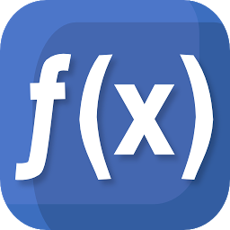
x1
y1
x15
y15
x2
y2
x14
y14
x3
y3
y13
y4
1.
e
r
x13
x4
O
v
a
l
l
g
D
e
s
i
n
x12
x5
y12
y5
x11
y11
x6
y6
x10
y10
x7
y7
x9
y9
x8
y8

Slide 6
Re
cog
tion
1）
ni
Lower
Lower
Lower
&
Cal
cu
tion
la
1
2
3
10
+
(
+
/
5
2
\n
*
^
)
9
11
2
1.
e
r
O
v
a
l
l
23
22
g
D
e
s
i
n
Result =
2）
Dr
aw
ing
Number
Symbol

Slide 7

Re
cog
tion
1）
ni
Initialize graphics mode
&
Cal
cu
tion
la
Set the resolution
sin
a
Build up
rectangular coordinate system
Build up
polar coordinate system
Function
Name
Operation
2）Drawing
the graph
Number
Line
or
putpixel
Symbol

Slide 8
Now we can run our MyPinater

Slide 9
Distribution
Li Yupeng
Liu Jinchan
1)MainCal
2)Instructions
3)Speech
4)PPT
1)Build up the stack
2)Judge figures
3)Judge priority
4)Choose system
5)Speech
Qin Qinan
Fan Shengyu
1)Get
2)Push into stack
3)Turn function Name
4)Set coordinate system
5)English annotation for project
6)Come up with new ideas
1)Initialize the stack
2)Pop from the stack
3)Change step
4)Draw coordinate system
5)English annotation for project
6)Come up with new ideas

Slide 10
Gain

Slide 11
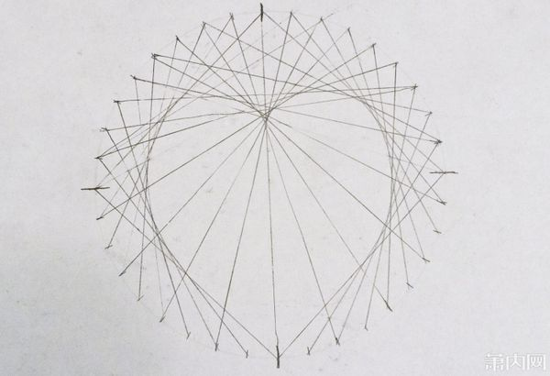

Slide 12



Slide 13
Thanks

